Slide 1
A Few-shot Neural Approach for Layout Analysis of Music Score Images
Presentation for ISMIR 2023
November 2023
Authors:
Francisco J. Castellanos¹
Antonio Javier Gallego¹
Ichiro Fujinaga²
¹ University Institute for Computing Research
University of Alicante, Alicante, Spain
² Schulich School of Music
McGill University, Montreal, Canada

Slide 2
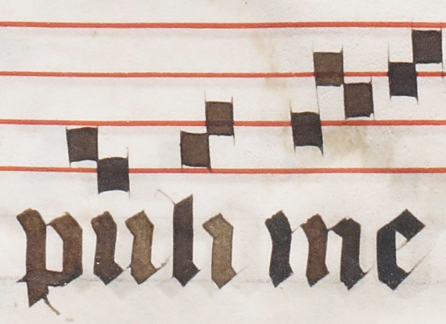
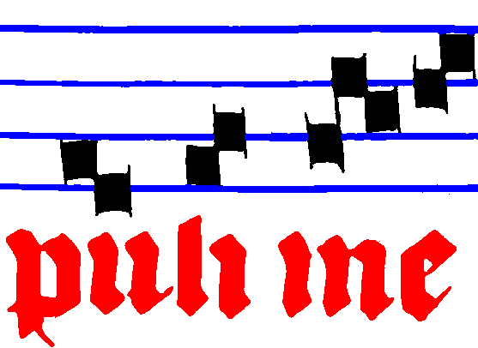
Layout Analysis (LA) for Optical Music Recognition
Document analysis process to segment the image.
LA

Slide 3
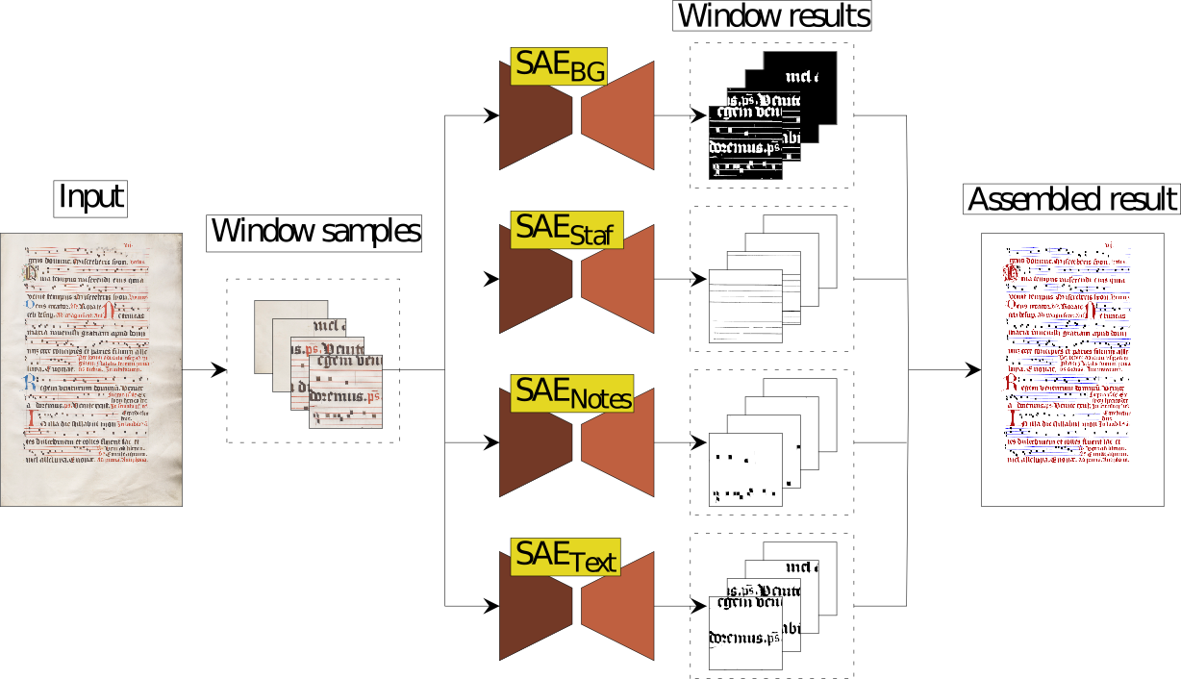
Layout Analysis (LA) for Optical Music Recognition
Previous work:
A Selectional Auto-encoder (SAE) for each layout of information.

Slide 4
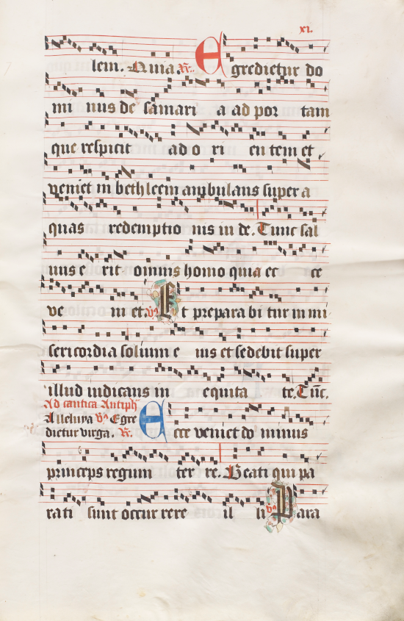
Motivation
High detail and density.
Full-page pixel-wise annotations.
High resolution.
Resolution: 5,896 × 3,839 px
To be annotated:
 | Symbols | 682,674 px.
 | Staff: | 557,169 px.
 | Text: | 1,572,082 px.

Slide 5
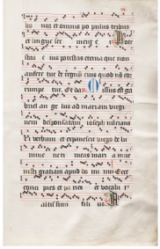
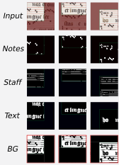
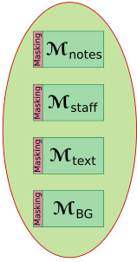
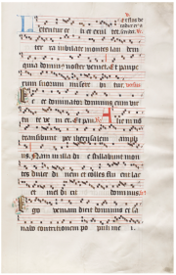
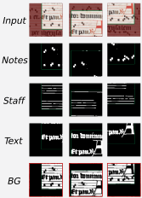
Proposal: Few-shot Layout Analysis
Input image
Training patches
Models
p₁
p₂

Slide 6
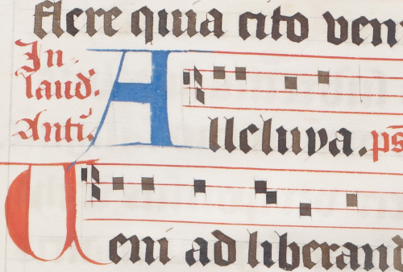
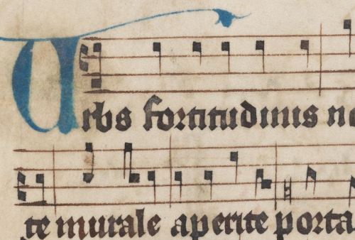
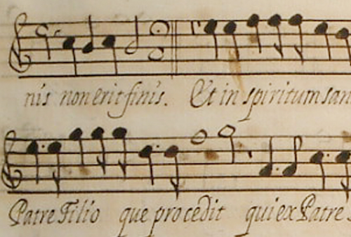
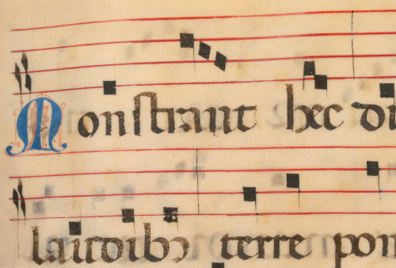
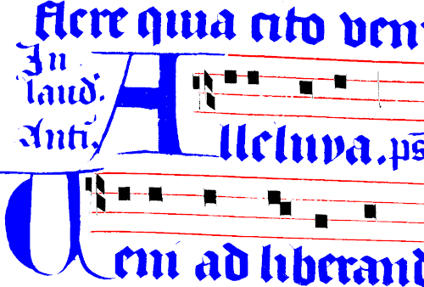
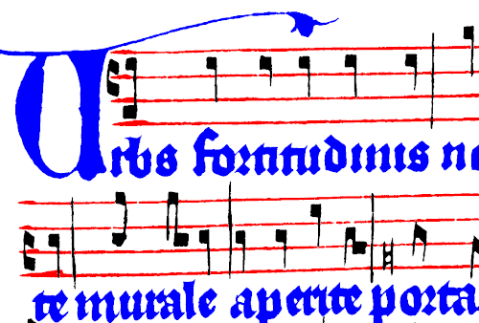
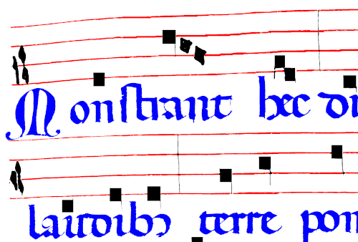
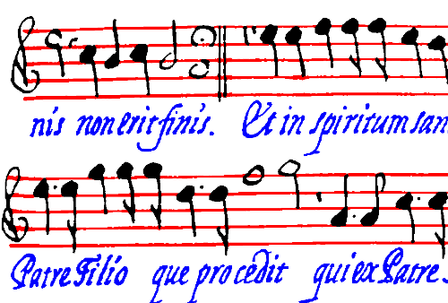
Corpora
Salzinnes
Einsiedeln
MS73
Capitan

Slide 7
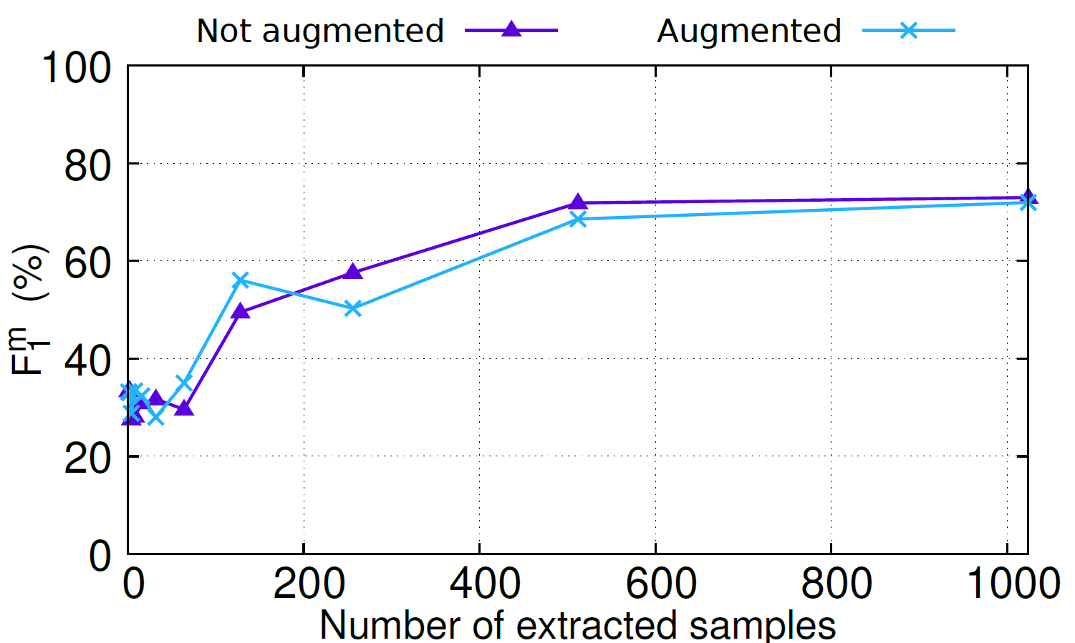
Preliminary results
1 annotated sample of 1 page.
No data augmentation is needed for our proposal.
Number of random samples: 512.

Slide 8
Experiments
Study case I: only 1 page available for training.
Study case II: variable number of pages for training.

Slide 9
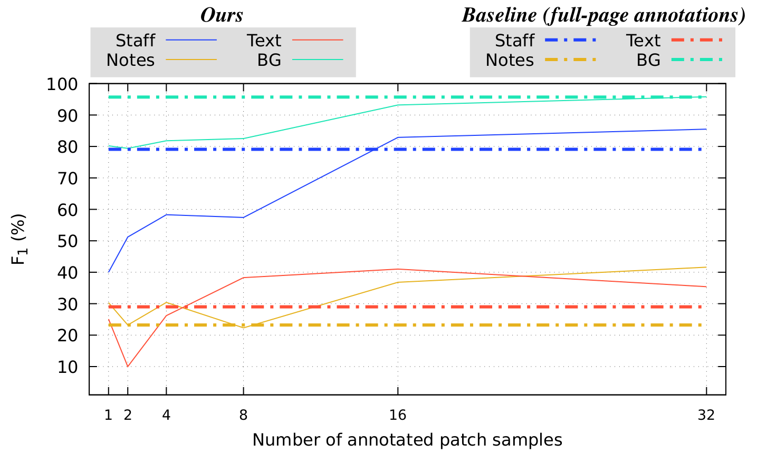
Results. Study case I: 1 page
Scenario with a limited training set (only 1 page)

Slide 10
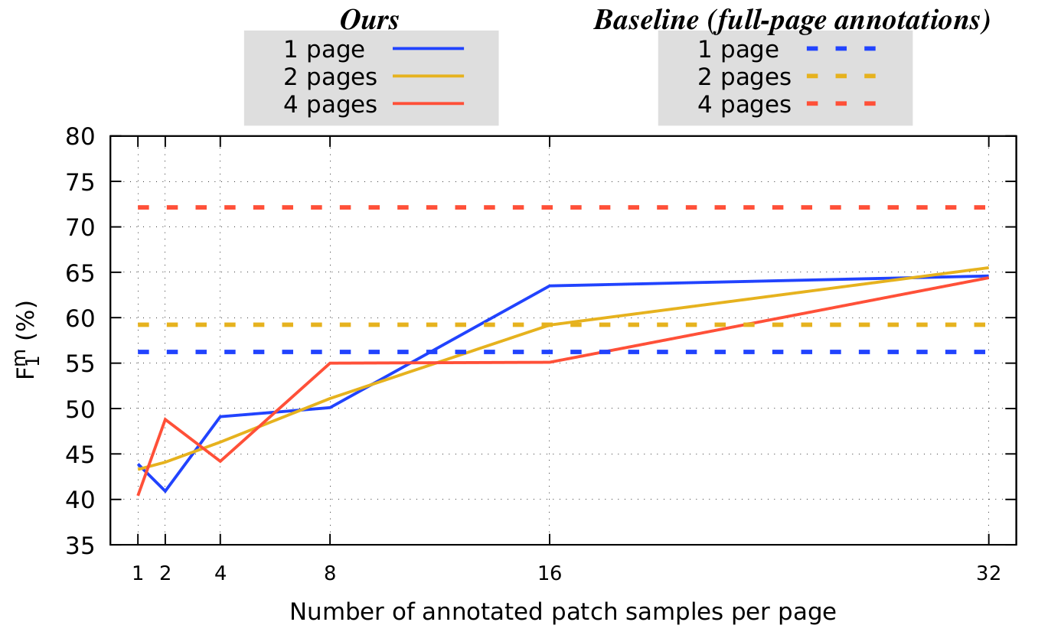
Results. Study case II: multiple pages
Scenario with variable number of pages.

Slide 11
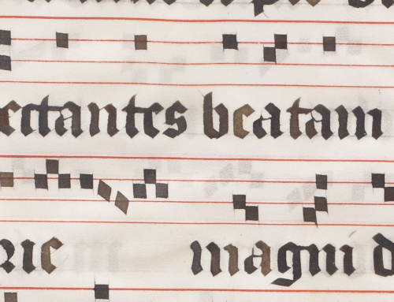
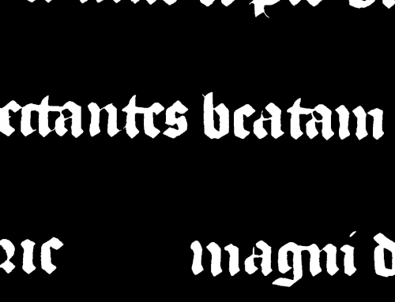
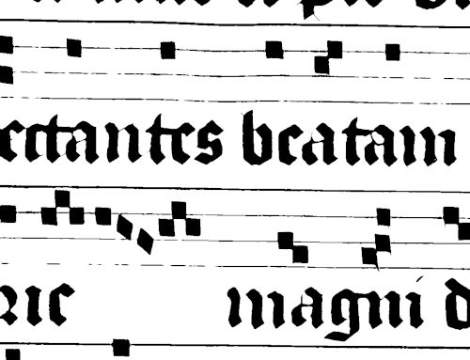
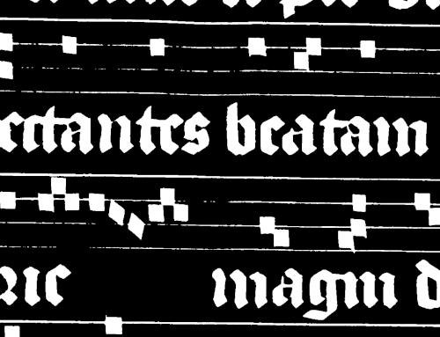
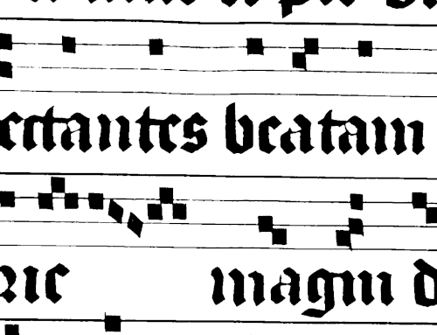
Input
Results. Qualitative result
32 annotated patches in one page
Staff
Notes
Text
BG
Ground truth
Prediction

Slide 12
Conclusions
One page is sufficient to obtain competitive performance.
Annotations are required for 32 patch samples of one page.
Our performance (65.5%) is near to the baseline (72%) with an important reduction in ground truth.
Our method improves the baseline with less than 4 pages.
There is still room for improvement.

Slide 13
Future work
We plan to investigate the combination of our proposal with:
Domain adaptation.
Incremental and active learning.

Slide 14
A Few-shot Neural Approach for Layout Analysis of Music Score Images
Presentation for ISMIR 2023
November 2023
This work was supported by the I+D+i project TED2021-132103A-I00 (DOREMI), funded by MCIN/AEI/10.13039/501100011033. This work also draws on research supported by the Social Sciences and Humanities Research Council (895-2013-1012) and the Fonds de recherche du Québec-Société et Culture (2022-SE3-303927).

